Slide 1

Code Basics P6 Providing marketing insights Codex Food and beverage
Presented by
Sam kumar r

Slide 2
Overview:
Codex is a German beverage company where they are planning to expand their market in India they have launched their product in India covering 10 cities a few months before so they have taken 10k responses from India by doing an survey
Primary insights
Secondary insights
Demographic insights
Consumer Preferences
Competition analysis
Marketing channels and brand awareness
Brand Penetration
Purchase behaviour
Product Development
Recommendations :
● What should be the ideal price of our product?
● What kind of marketing campaigns, offers, and discounts we can run?
● Who can be a brand ambassador, and why?
● Who should be our target audience, and why

Slide 3
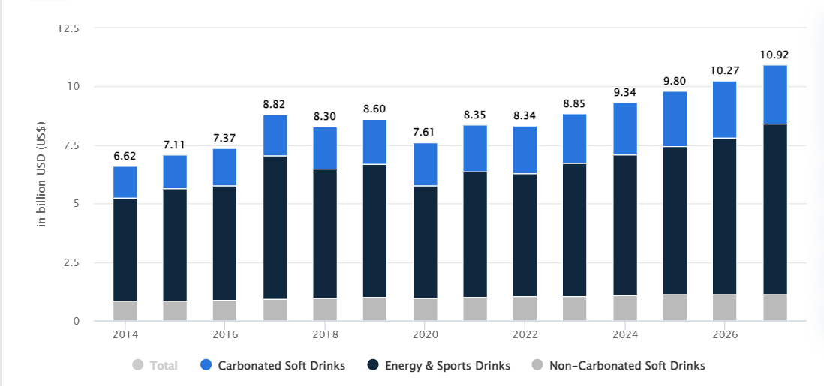
Market:
Revenue in the Soft Drinks segment is projected to reach US$8.85bn in 2023, with a 5.40% annual growth rate (CAGR 2023-2027).
Volume in the Soft Drinks segment is expected to reach 7.82bn L by 2027, with a 3.9% growth rate in 2024.
The average volume per person in the Soft Drinks segment is anticipated to be 4.89L in 2023.

Slide 4




Task:
Tools used
Data cleaning
The provide recommendations and insights To codex
To improve Brand awareness
To increase Market price
To increase Productivity
Python (pandas , NumPy, matplotlib, seaborn)
Power point
Most of the respondents may not have answered honestly such as:
if heard before is no then Tried before has to be no
if Tried before is no then Taste experience to be Not applicable
if Tried before is no then Reasons preventing trying has to be Not applicable

Slide 5
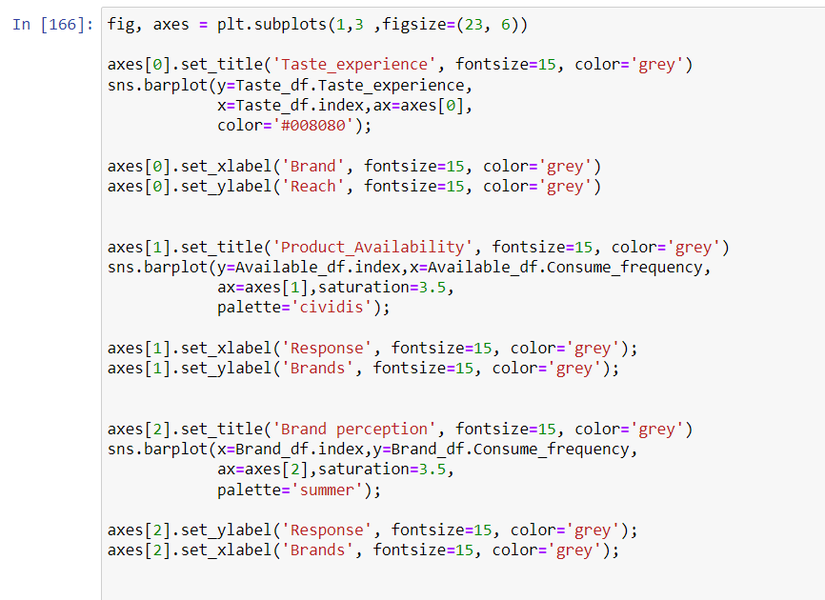
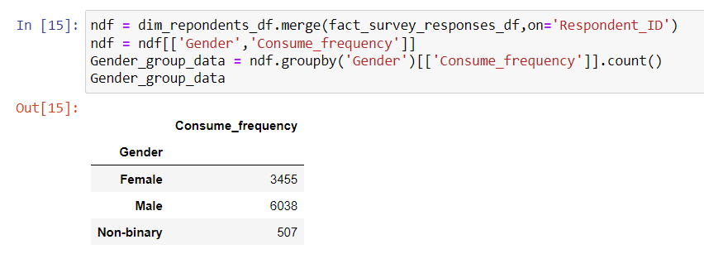
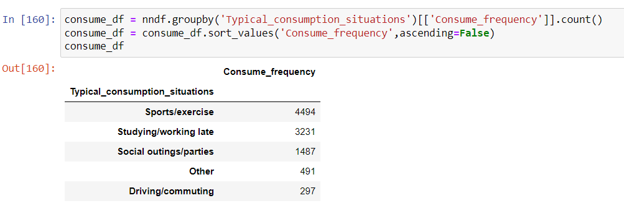
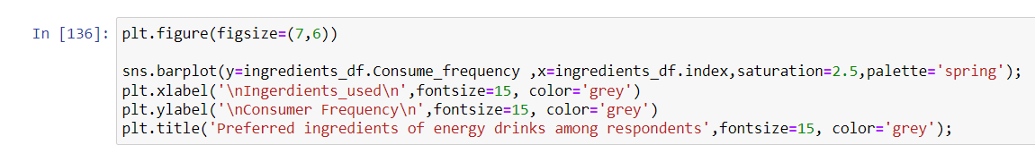
Images of the code

Slide 6
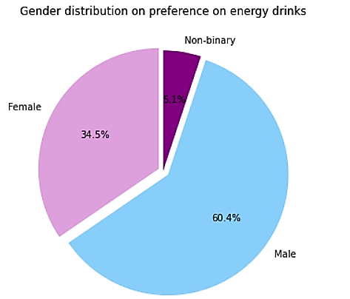

1 : Demographic Insights
a. Who prefers energy drink more?(male/female/non-binary?)
The majority of the response are from males, approximately 60.04% where female consisting of 34.5% and the least of 5.1% from non binary
60.4%

Slide 7
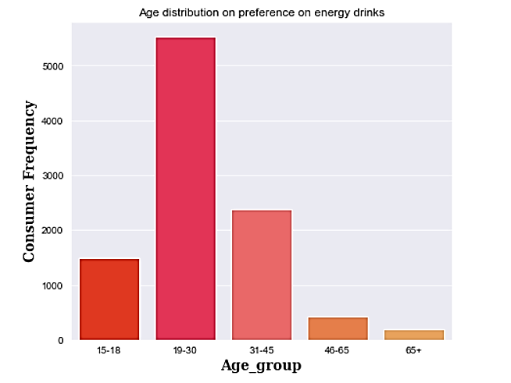
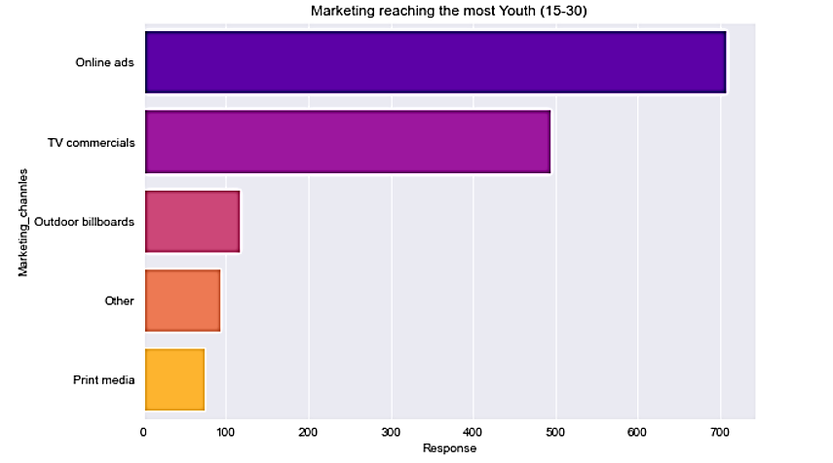

b: Which age group prefers energy drinks more?
The Majority of the responses are from Age group of 19-30
Where 19-30 can be working professional and college students
From this insight now The company have now have a Target audience to focus on the age group of 19-30
C: Which type of marketing reaches the most Youth (15-30)
Online ads is the type of marketing which reaches customer more where in today’s era most of the consumers spend their time in digital platforms like Instagram, Facebook, YouTube etc.

Slide 8
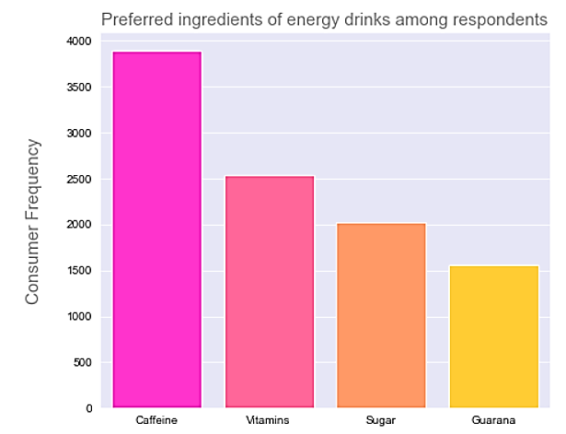
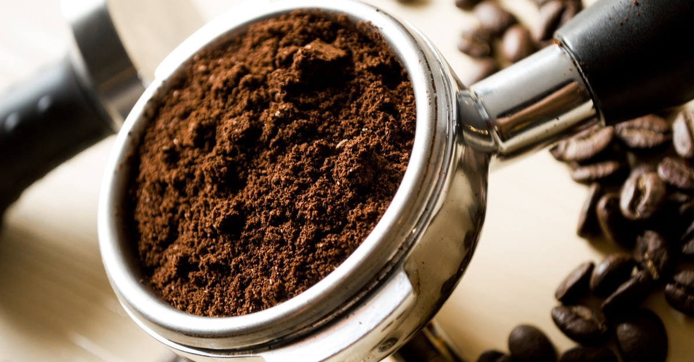
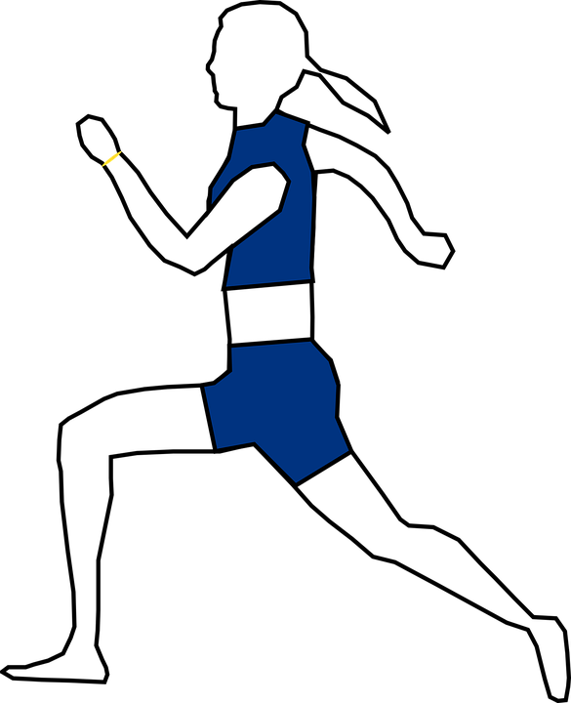
2 : Consumer Preferences :
a. What are the preferred ingredients of energy drinks among respondents?
Caffeine is the mostly preferred ingredient among the respondents followed by vitamins Caffeine is a drug that stimulates (increases the activity of) your brain and nervous system.
The data represents that most likely the consumers are included sports ,
Gym activity where it requires more energy
Insights
Codex can improve Caffeine in their product or introduce new coffee flavour since many of the respondent prefer caffein and it is widely present in Coffee
Codex now have target audience who they can focus on such as respondents included in sports and exercise

Slide 9
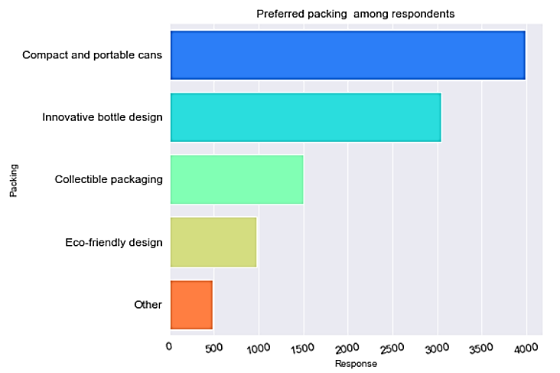
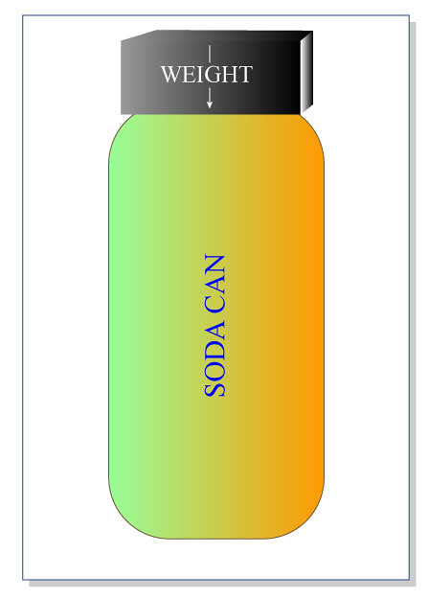
B. What packaging preferences do respondents have for energy drinks?
The majority of the respondents prefer Compact and portable due to they are small-sized containers that are designed to be easily carried or transported. They are typically lightweight, easy to handle
Insights
Codex can initiate themselves in packing the product in Compact and portable form or produce it in such a way where consumers can easily carry and Transport it from one place to another

Slide 10
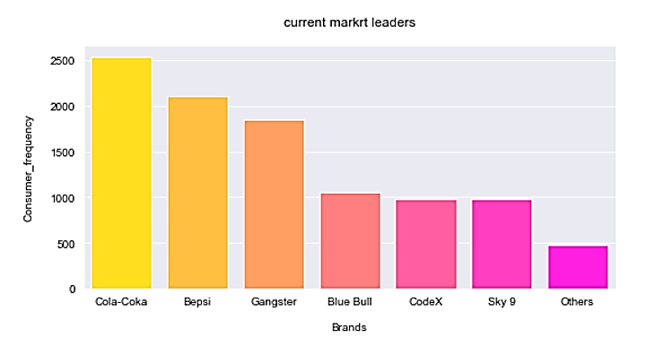
3 Competition Analysis:
a. Who are the current market leaders?
The current market leaders are cola-coka followed by Bepsi and Gangster ,They are top 3 current market leaders where Codex stands 5th in the Competition

Slide 11
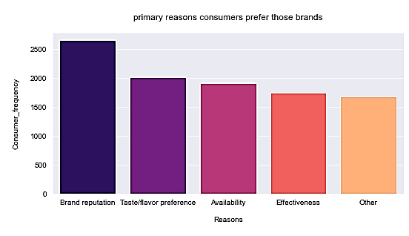
b. What are the primary reasons consumers prefer those brands over ours?
The primary reason prefer those brands over ours is Brand
Reputation followed by Taste/preference/flavor where Brand reputation plays a vital in consumer choosing the brand
.
Insights
Codex can initiate themselves in improving brand reputation by following points:
Deliver exceptional products or services
Provide excellent customer service.
Practice transparency and honesty in all business practices.
Engage with online reviews and feedback.
Monitor and manage your online presence.

Slide 12
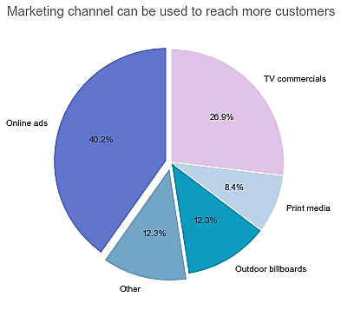
4 Marketing Channels and Brand Awareness:
a. Which marketing channel can be used to reach more customers?
online marketing can be used to reach more customers since
Most of the customers in today’s era use digital platform in their day to day basis
.
Insights
Codex can improve their online ads or their digital presence to improve their brand in online by following
Define your brand identity.
Understand your target audience.
Craft compelling ad headlines.
Use captivating visuals.
Create concise and impactful ad copy.

Slide 13
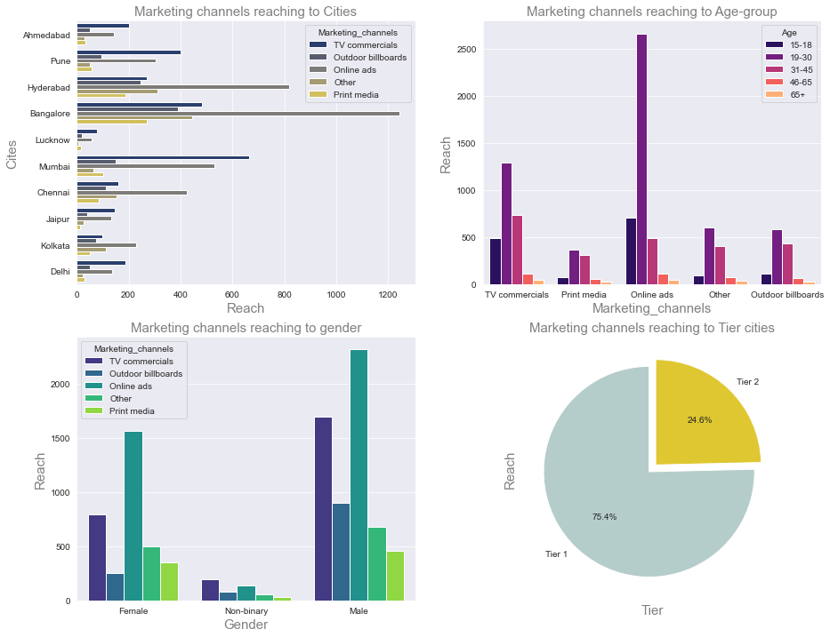
b. How effective are different marketing strategies and channels in reaching our customers? I have used matplotlib. Subplots (plt.subplots) and seaborn packages for this in Jupyter notebook

Slide 14


b. How effective are different marketing strategies and channels in reaching our customers?
Insights
Bangalore has the highest reach in online ads and followed by Hyderabad Surprisingly cities like Mumbai , Lucknow ,pune, Ahmedabad ,Delhi, Jaipur ,Tv commercials have greater reach to respondents than online ads and other Marketing channels
Online ads are reaching to most of the respondents from the age group of 19-30 and followed by Tv commercial
Tier1 75.4%
Male have the highest respondents of all the marketing channels
Tier 1 have the highest respondents of all the marketing channels containing 75.4%

Slide 15
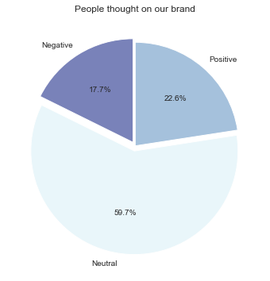
5. Brand Penetration:
a. What do people think about our brand?
59.7% of the respondents are neutral and 22.6% of the respondents are positive about Codex and only 17.7% of the respondents have negative felling about Codex
.
Insights
Since 59.7% of the respondents have neutral perception about Codex and since positive % is higher than lower % , So Codex can implement new strategies and ideas such as
improving availability
increasing caffeine in product
Brand value
Understand your target audience. there
is high chance of neutral respondents converting into positive respondents

Slide 16
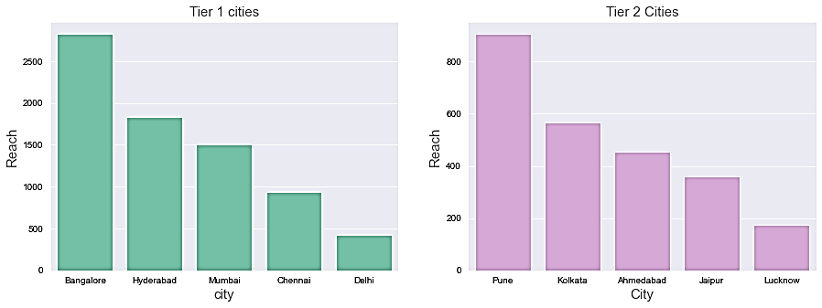
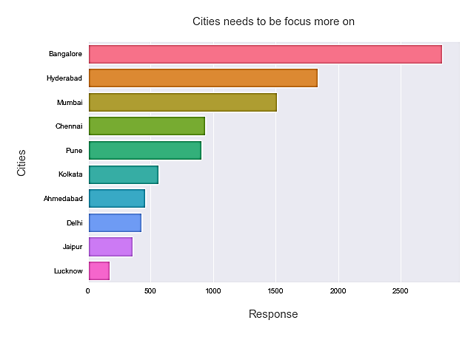
b. Which cities do we need to focus more on?
.
Insights
Focus more on
T1 : Chennai
Delhi
T2 : Jaipur
Lucknow
At overall level the city needs to be focused on are :
Ahmedabad
Delhi
Jaipur
Lucknow

Slide 17
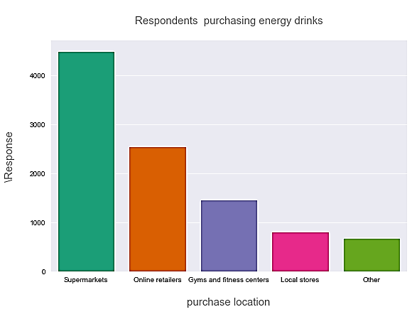
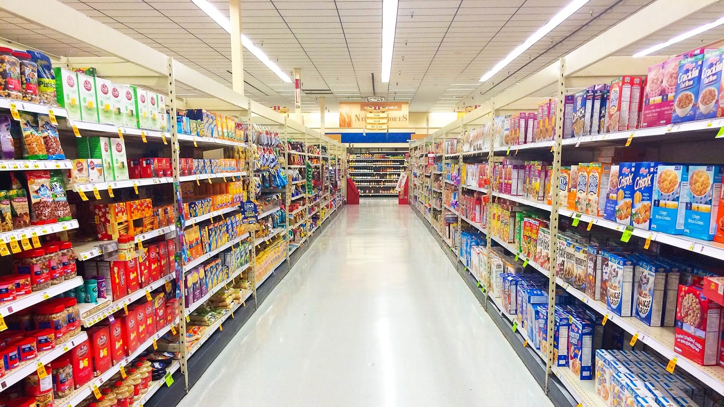


6. Purchase Behaviour:
a. Where do respondents prefer to purchase energy drinks?
Most of the respondents purchase their energy drinks from Supermarket followed by Online retailers
.
Insights
Since most of the respondents purchase their energy drink from super market so the following points can be applied to increase their sales and Brand value :
Eye-catching Packaging
Clear Product Information
Competitive Pricing
Product Placement
Product Sampling

Slide 18
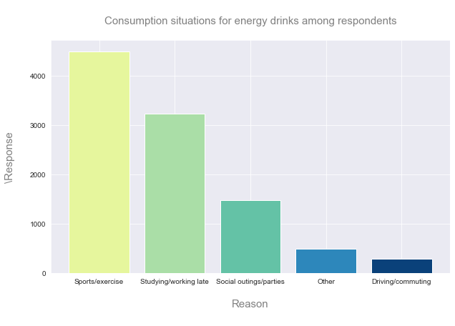
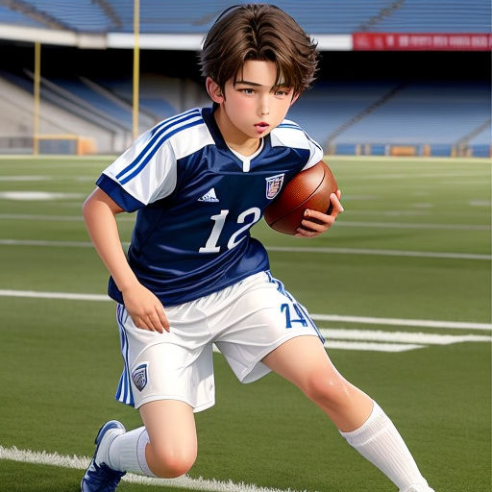
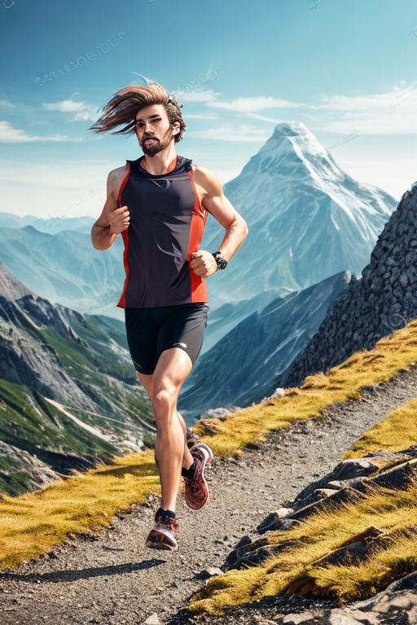
b. What are the typical consumption situations for energy drinks among respondents?
Most of the respondents typical consumption energy drinks is for sports and exercise and typically 19-30 age group of people are actively involved in it and that is the reason they prefer caffeine which helps them to perform effectively
Insights
Codex now have Target audience which they can focus on:

Slide 19
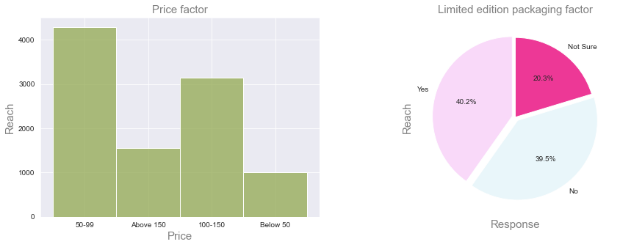
c. What factors influence respondents' purchase decisions, such as price range and limited edition packaging?
Insights
Most of the respondents prefer a price range of 50-100 and followed by 100-150
The consumer’s are excepting good quality along with reasonable price
Almost 40.2% of the respondents prefer limited edition packing and almost 39.5% prefer no to

Slide 20
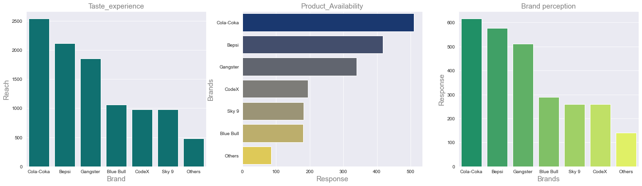
7. Product Development
Insights
In Taste experience Codex ranks at 5
So, codex has to increase their taste in the Product
In Product availability Codex ranks at 4 So, codex has to make the availability of the product in different stores and supermarkets
In Brand perception Codex ranks at 6
So, codex has to mainly focus on Brand perception by making Brand ambassador , and sponsor various brands and do promotion activates

Slide 21
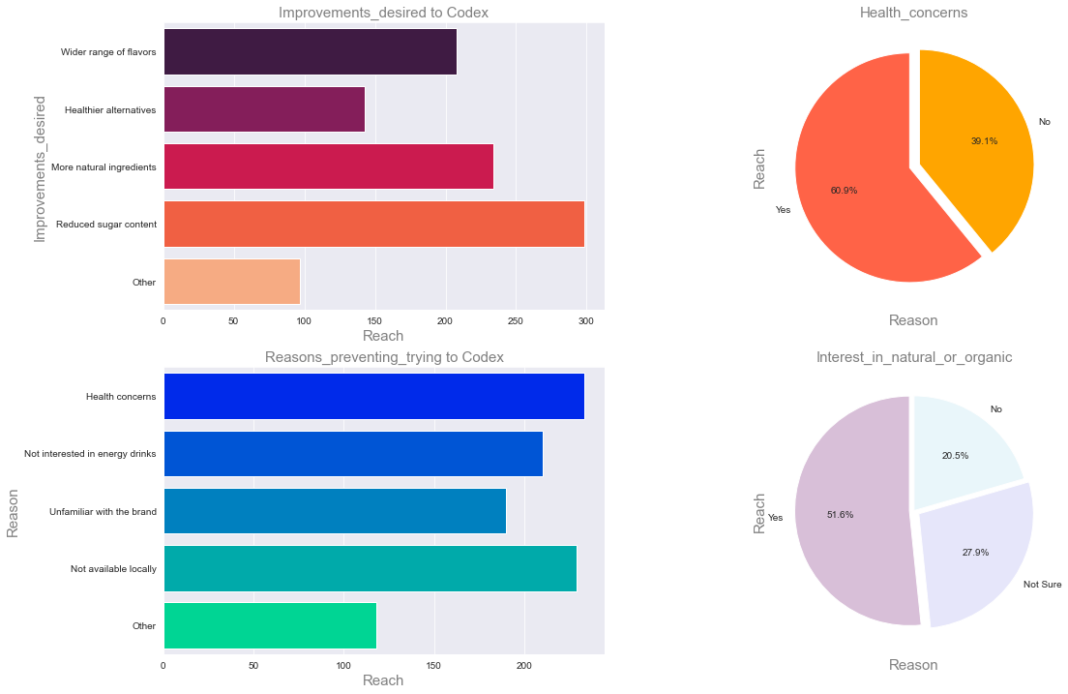
Other aspects and insights

Slide 22

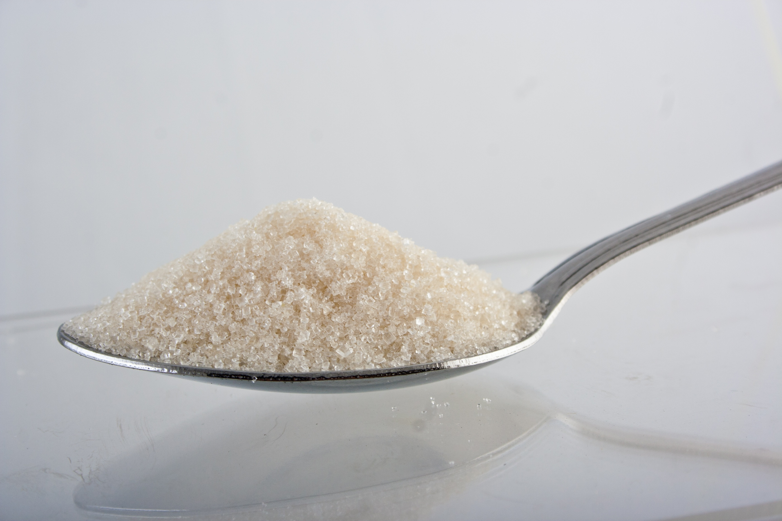



This insights are drawn only from the data of Codex
Insights
Codex should reduce the sugar content in their product since most the respondents prefer less sugar content in their drink
Which represents that most of the respondents are concerned with their health
Almost 60.1% of the respondents are health concerned
And 39.1% are not
So it clearly shows that Codex should focus on producing healthy drinks to the consumers
The primary reasons for most of the consumers preventing Codex is Health concern and followed by not available locally
So Codex should focus on these two aspects
About 51.6% of the respondents are interested in natural ingredients and 27.6 and not sure
And 20.5% are not
So it clearly shows that most of the respondent's are in natural ingredients and health concerned

Slide 23
5 recommendations for Codex
Insights
1 : What immediate improvements can we bring to the product?
The primary reason respondents preventing to try Codex’ is not availability in local and health concern
Codex should produce their drink with natural ingredients which can be considered heathy
Codex product should be available locally so they should include their product in local stores and supermarkets
codex has to focus on Brand perception by making Brand ambassador , and sponsor various brands and promotion activities
2 : What should be the ideal price of our product?
The ideal price range of our product can be 50-100 and followed by 100-150
The consumer’s are expecting good quality along with reasonable price

Slide 24


3 : What kind of marketing campaigns, offers, and discounts we can run??
Social media contests with prizes like free cases of soft drinks.
Loyalty program offering points for purchases and redeemable discounts.
Limited-time promotions such as "Buy One, Get One Free" deals.
Collaborations with local businesses for joint promotions or bundled deals.
Sampling campaigns at popular locations to give people a chance to try our soft drinks.
4 : Who can be a brand ambassador, and why?
Virat Kohli can be our brand ambassador the reasons are
Since Virat is in his peak of his carrier and since many of our respondents are involved in sports and exercise , since he his a cricketer and have huge following in Instagram , so Virat Kohli can be considered as our brand ambassador

Slide 25

5 :Who should be our target audience, and why?
Our Target audience should be :
Age group of 19-30 as the data shows due the age group
19-30 are most actively involved in it
Our Target audience should be :
People involved in sports & exercise and any type of physical activity

Slide 26
Thank you
Code basics and Team

